Slide 1


Traffic Intensity Prediction and Recommendation
Domain: Machine Learning (ML), Web Application Development
Undertaken by A. R. Shaikh (Student, MIT WPU, Pune)

Slide 2
Agenda
Brief / Scope
Motivation
Classification Vs Regression
ML process
About the Dataset
See how ML algorithm worked
Predictions
Comparison of predictions
Junction Properties
Use-case diagram
Requirement Specifications

Slide 3
Brief/Scope
Web application design and implementation of Traffic Intensity Prediction and Recommendation, a Machine Learning (ML) project
For prediction purposes of the intensity of traffic at a particular junction and recommendation of possible solution to overcome congestion at that junction
Application is based on a to-be-trained ML algorithm on which the provided data is predicted against
Several ML algorithms will be reviewed and studied for future enhancement of the project

Slide 4
Motivation
Expressions of increased traffic:
Reduction in traffic speeds, (increased journey times)
Increased fuel consumption
Environmental pollution
Factors:
Acceleration of urbanization,
Population growth,
Unimproved road conditions, bring great pressure to urban traffic management
Can help:
Assist route planning
Alleviate congestion, etc

Slide 5
Continued
Growing available traffic related datasets provide us potential new perspectives to explore this problem
Goal:
To predict intensity of traffic over given period of time and recommend if solution to overcome congestion is necessary or not and show how many districts needed how many treatments.

Slide 6
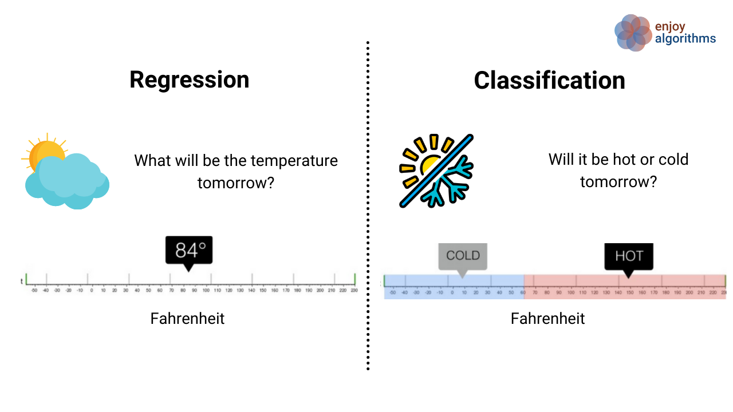
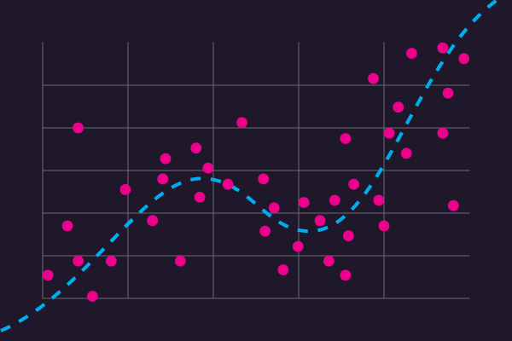
Classification Vs Regression
Available Regression Algorithms:
Random Forest Regression
Gradient Boosting Regression
Linear Regression
Logistic Regression
Ridge Regression
Bayesian Ridge Regression
Lasso Regression

Slide 7
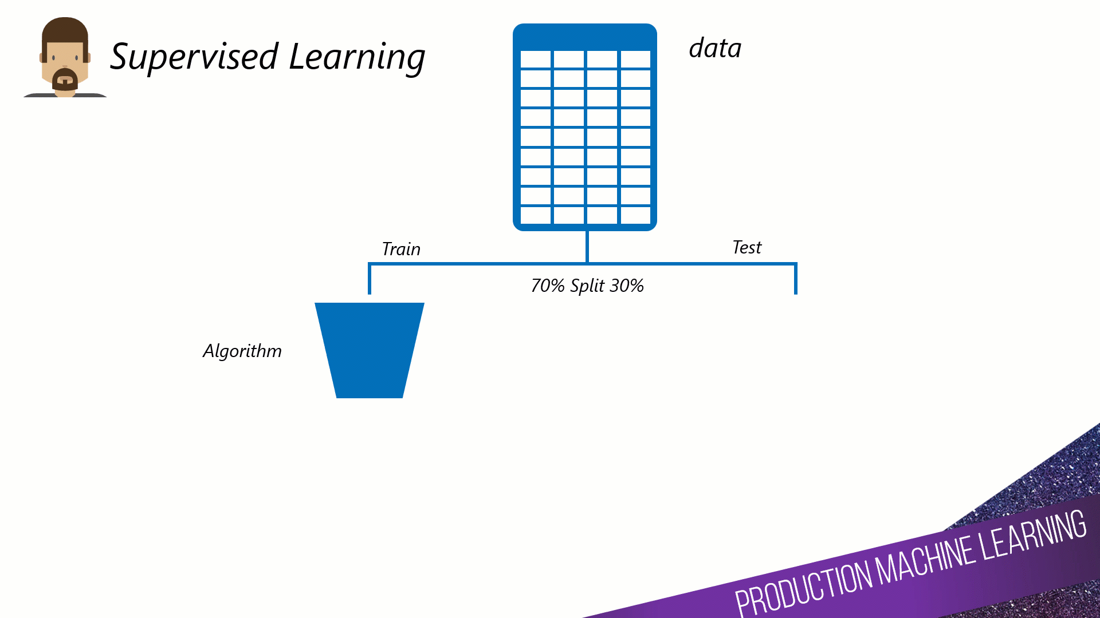
ML Process

Slide 8
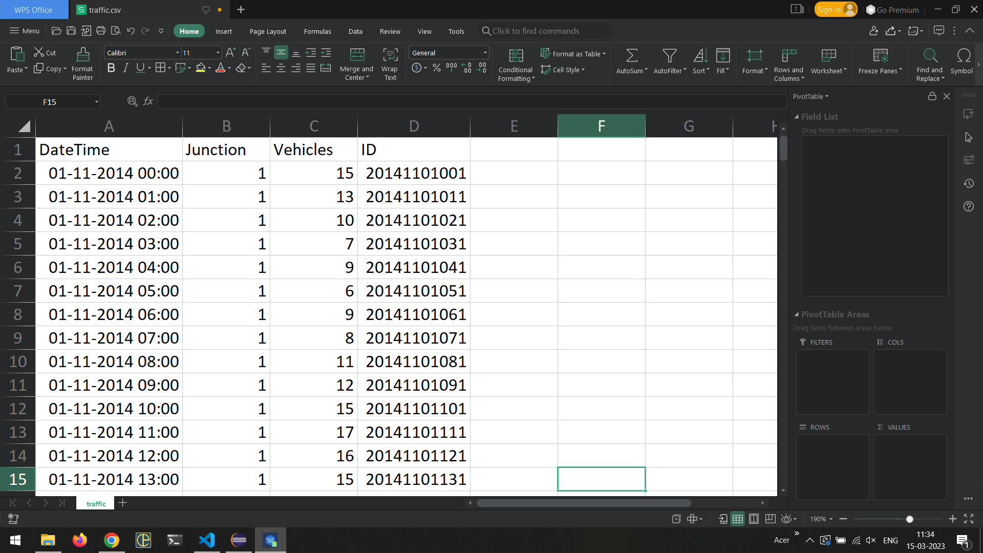
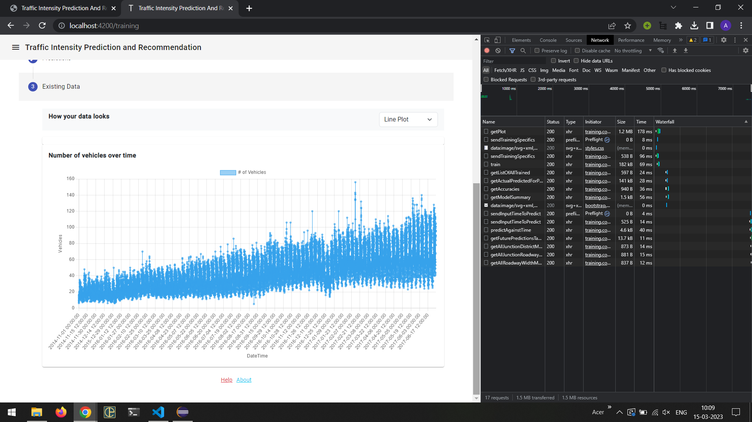
About the dataset
Downloaded from Kaggle
https://www.kaggle.com/datasets/fedesoriano/traffic-prediction-dataset
Type: CSV or XLSX file
Contains features
Junction Name
Date-time
Number of Vehicles
A single row of csv data represents:
Number of vehicles at the junction at given date-time
Can be:
Hourly data,
Daily data,
Monthly data

Slide 9
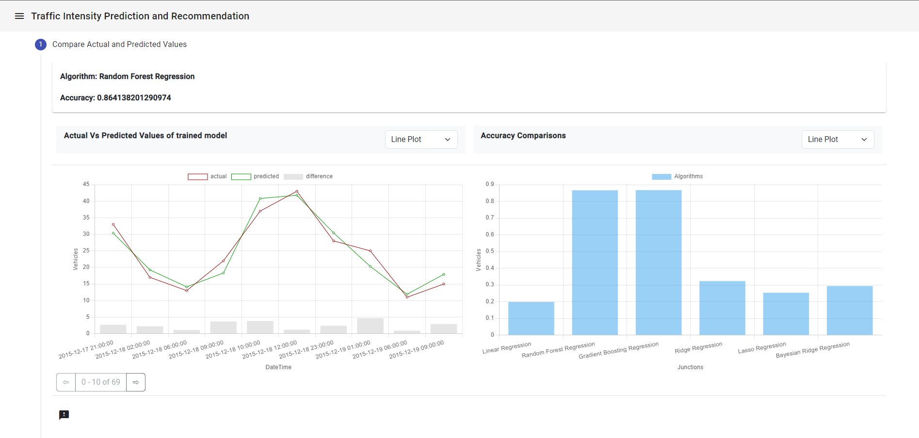
See how ML algorithm worked

Slide 10
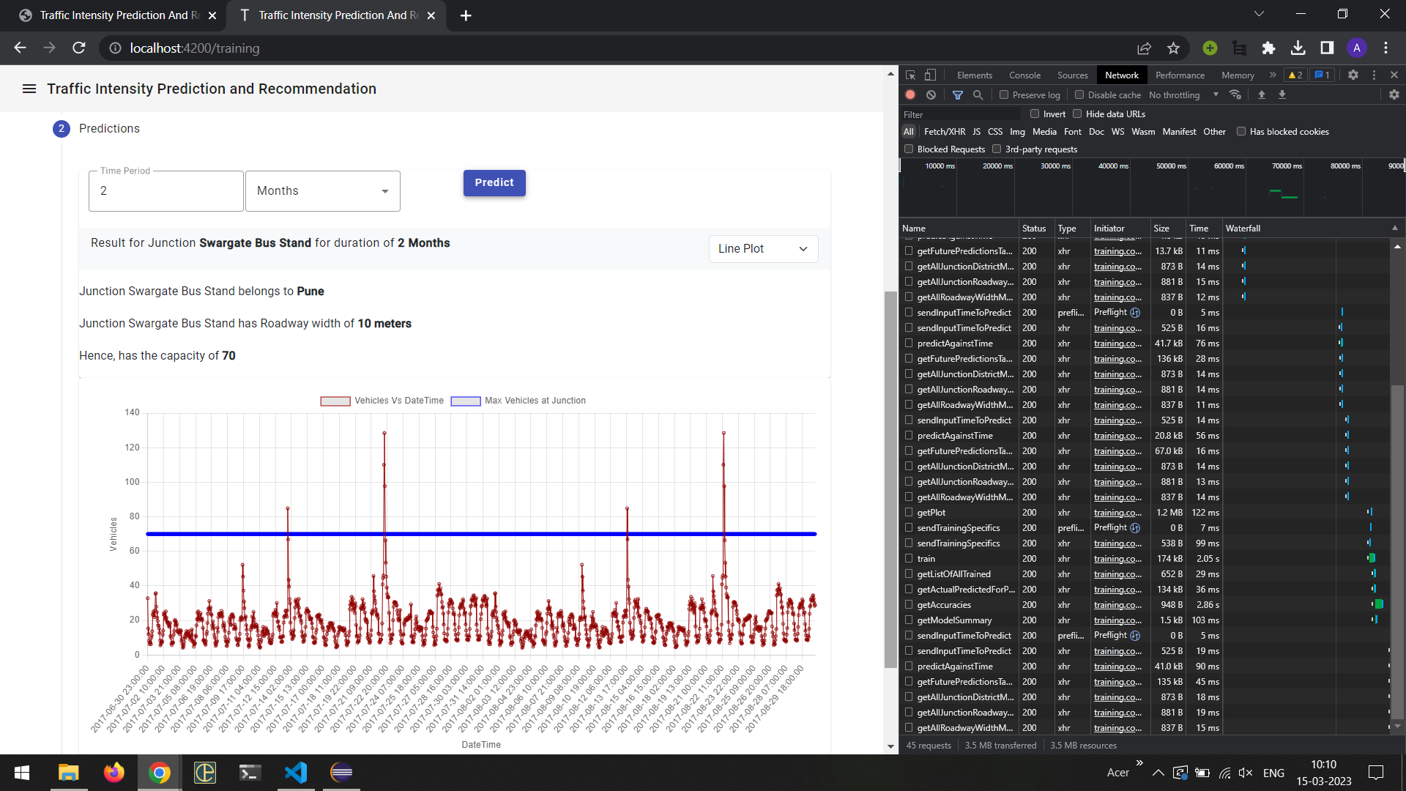
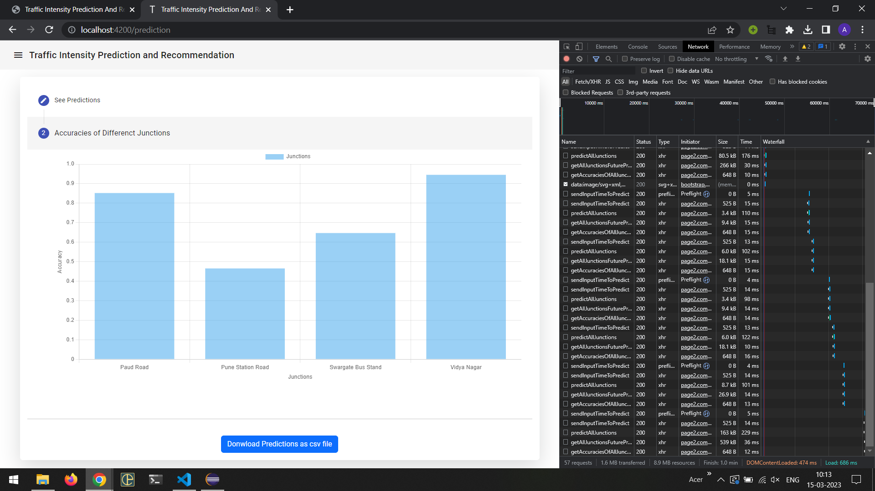
Predictions (Auto and Manual)

Slide 11
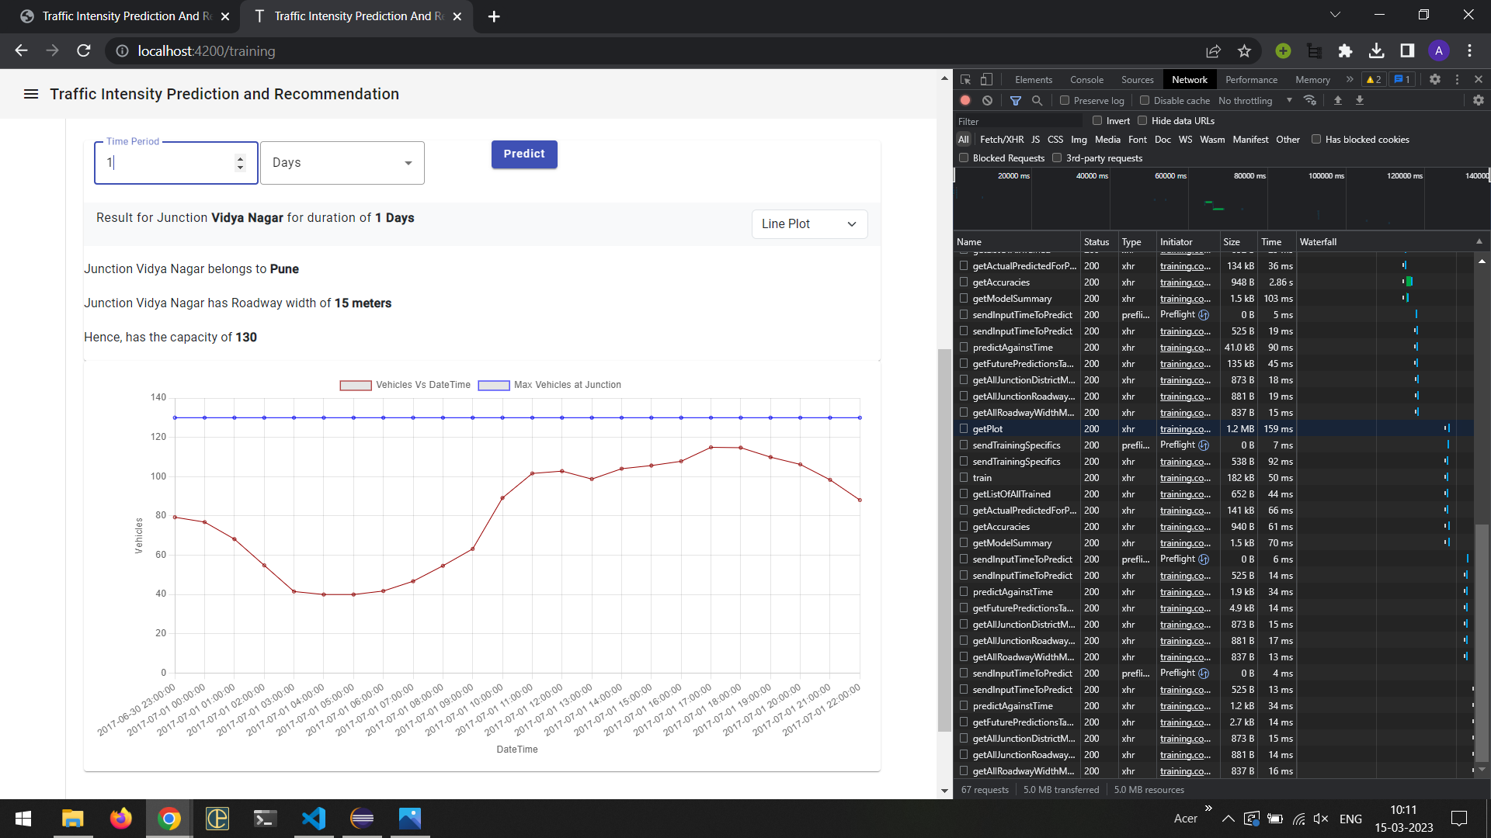
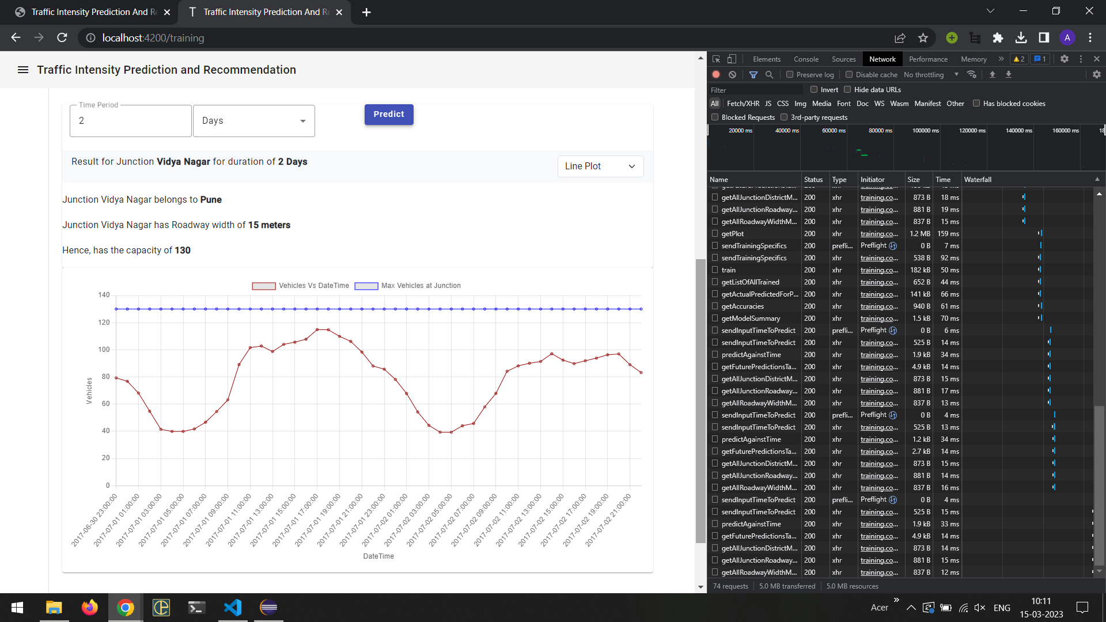
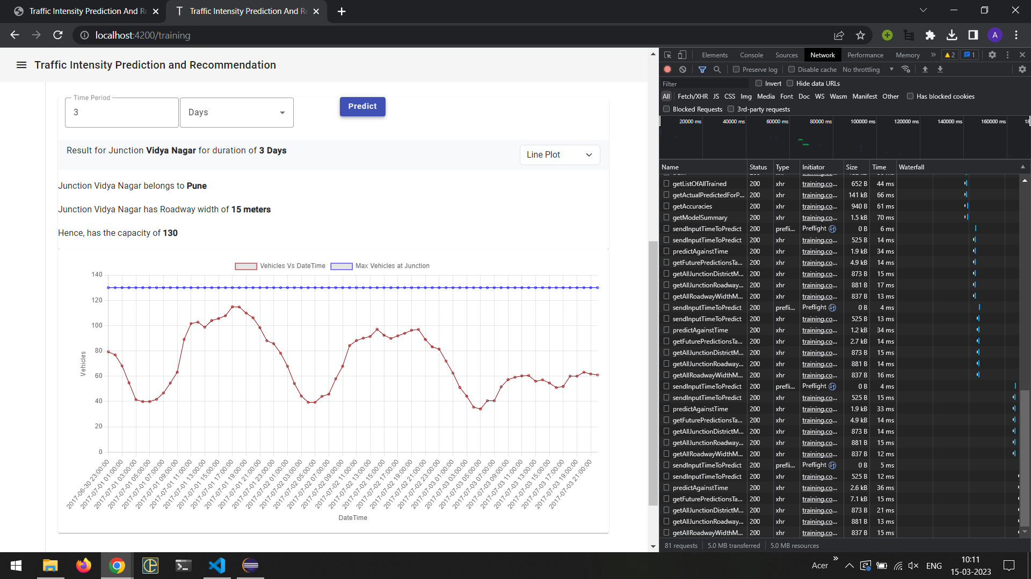
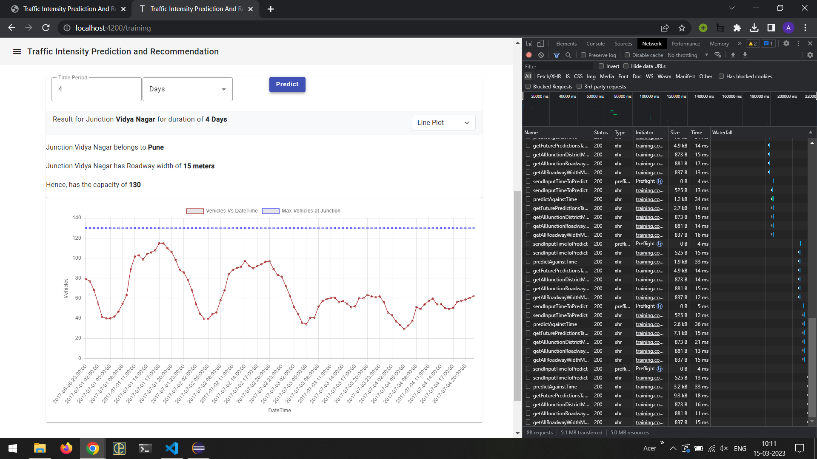
Comparison of different prediction times (1 day, 2 days, 3 days, 4 days)

Slide 12
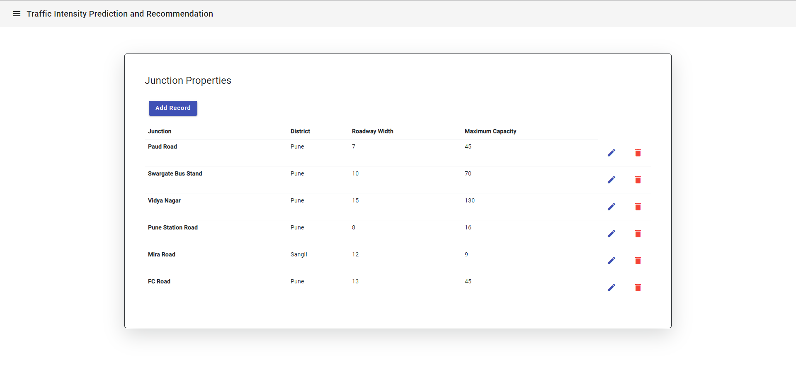
Junction Properties

Slide 13
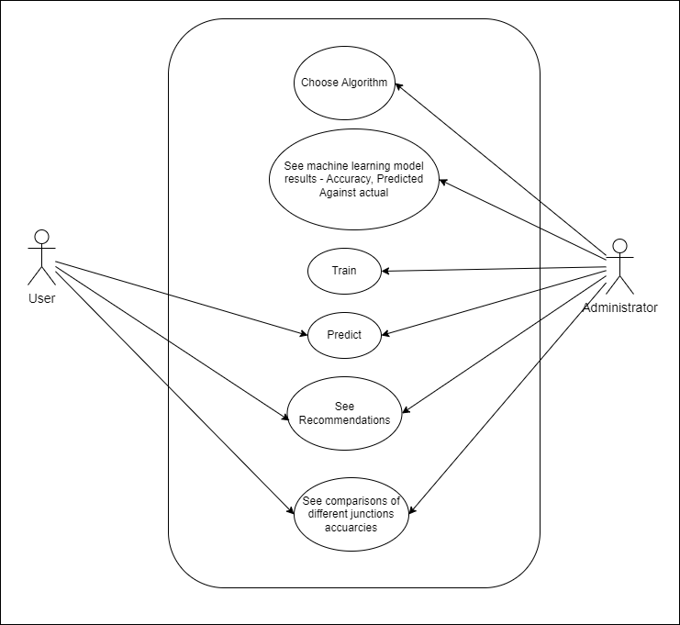
Use Case Diagram

Slide 14
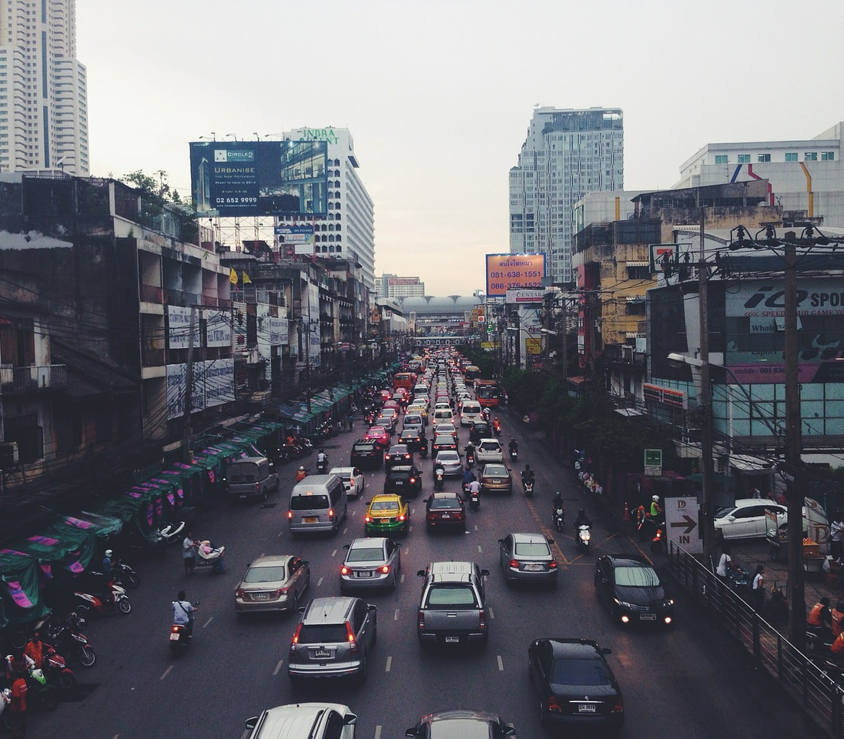
Thank You

